Slide 1
How Floating Point Numbers Are Stored In Memory
(IEEE-754 standard)

Slide 2
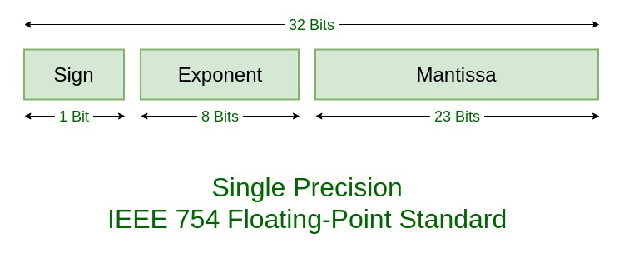
Decimal-Base-10 (0,1,2,3,4,5,6,7,8,9)=>10 Binary-Base (0,1)

Slide 3

Take the value 10.75
10.75 => 107.5x${10}^{−1}$
10.75 => 0.1075x${10}^{2}$
107.5x${10}^{1}$ exponent
base
Mantissa

Slide 4


How much space it take
32 BIT (4 bytes)

Slide 5
10.75 to binary
Step no 1: first convert the value before decimal
That is 10
So,
128, 64, 32, 16, 8, 4, 2, 1

Slide 6
Remaining .75
Step no 2: multiply it with two
.75 x 2 = 1.50 seprate 1 from it
.50 x 2 = 1.00 seprate 1 when we get 0 stop the multiplication
(10.75)10 => (1010.11)2

Slide 7

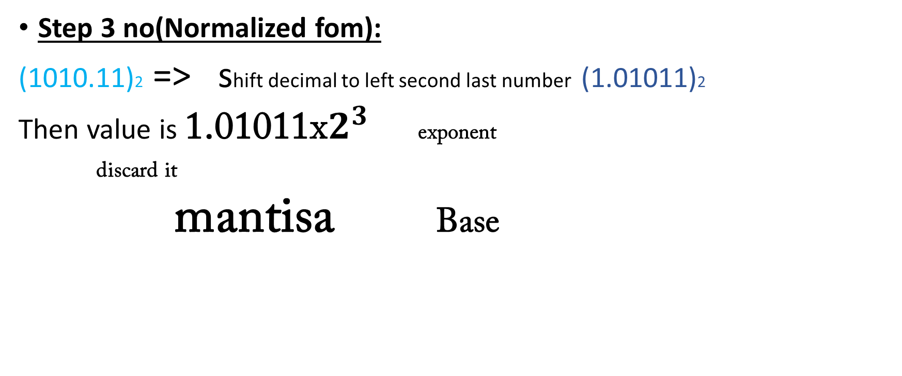

Step 3 no(Normalized fom):
(1010.11)2 => shift decimal to left second last number (1.01011)2
Then value is 1.01011 x $2^{3}$ exponent
discard it
mantisa Base

Slide 8

Add Bias() value
Step no 3:
Bias = $2^{n−1}$-1
n= 8bit(exponent)
$2^{8−1}$-1
$2^{7}$-1
128 – 1
n =127

Slide 9
Add exponent that is 3 add in bias value
127 + 3 = 130
128 64 32 16 8 4 2 1
That is 10000010

Slide 10

So,
Our value is 10.75 it is a positive value

Slide 11

Supose wi have –ve number 0.1075
Min = 0
max = 255 (divided into two parts)
0 - 255

